Slide 1
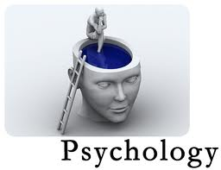

Slide 2
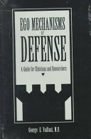

Slide 3
PSYCHOLOGY
scientific study of behavior and mind

Slide 4
Psychology
Behavior Mental Process
walking ←
Talking ←
Eating ←
Crying ←
We learn behavior through Punishment and Reward (pave love and skinner)
Behavior therapy

Slide 5
Cognitive therapist (Aaron T Beck)
Psychology
Behavior Mental process (cognition)
→ Thinking (concrete, abstract,
Ideas, creativity)
Learning → Memory
→ Perception
→ Problem solving
→ Decision making
Cognitive - Behavior therapy

Slide 6
Mental process (cognition) (Affection)
(IQ) (EQ) Thinking Feelings
Memory Emotions
Perception Moods
Problem solving
Decision making
Attacks

Slide 7
Attacks
Negative emotions
Unpleasant feelings
Guilt feelings
Shame
Hurted

Slide 8
Mental process (cognition) EGO (Affection)
(IQ) (EQ) Thinking defense Feelings
Memory mechanism Emotions
Perception Moods
Problem solving
Decision making
(Strong Ego)

Slide 9
Mental process (cognition) (Affection)
(IQ) (weak ego) (EQ) Thinking Feelings
Memory Emotions
Perception Moods
Problem solving
Decision making

Slide 10
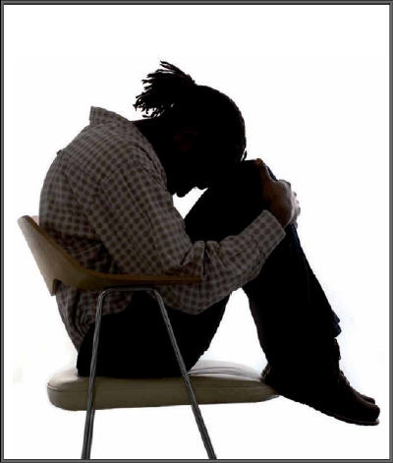
Ego melt down, guilt, fail coping

Slide 11
Ego defense mechanism
safeguard and emergency tools to cope with unpleasant feeling and negative emotions these defense mechanism strengthen the ego functioning

Slide 12
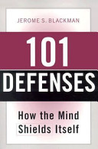

Slide 13
11 – recommended, healthy, positive
Ego defenses .strengthen the ego
functioning
11 – unhealthy, poor, weak Ego defense
that lead to depression, suicide, addiction.

Slide 14
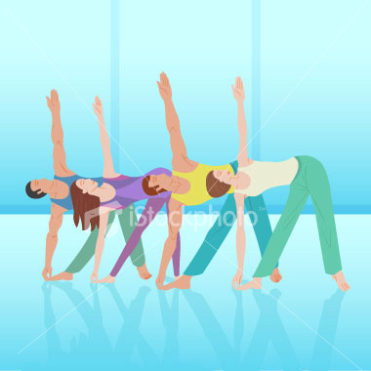
Healthy ego defenses

Slide 15
1

Slide 16
Suppression
you make a conscious decision to push that feeling down or go for a jog or take a cold shower.
Repression is subconscious, and Suppression is conscious. Both repression and suppression are a denial of a memory

Slide 17
2

Slide 18
Isolation of Affects
Reduce stress by thinking of the shocks as interesting new physiological sensations. one may attempt to resolve an emotional conflict by separating or objectively ditching ideas from associated feelings.

Slide 19
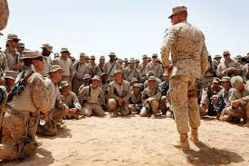
Isolation of Affects

Slide 20
3

Slide 21
Intellectualization
avoid thinking about the stressful, emotional aspect of the situation and instead focus only on the intellectual component. a person might employ intellectualization to distance from the impulses, event or behavior and focus to find opportunities in optimal manners.

Slide 22
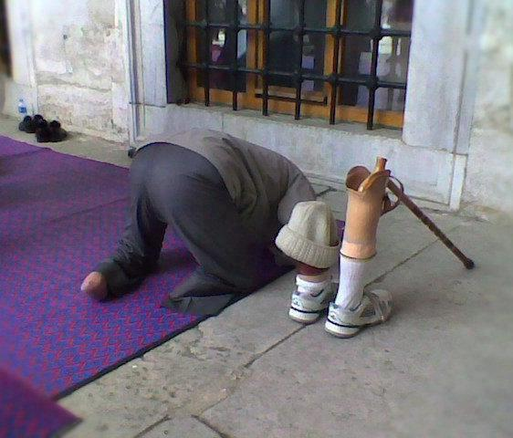
Intellectualization

Slide 23

Thinking about the stressful, emotional aspect

Slide 24

Intellectualization

Slide 25
4

Slide 26
Rationalization (Reasoning)
protect self-esteem and self-concept.
involves explaining an unacceptable behavior or feeling in a rational or logical manner, avoiding the true reasons for the behavior.

Slide 27
5

Slide 28
Hummer
(Fanny way)
laughter has been shown to reduce stress, boost the immune system and enhance brain chemistry through the release of serotonin and endorphins. Humor is a very effective means of dealing with overwhelming emotion and taking control of a situation.

Slide 29
6

Slide 30
Minimization
Minimization is one of the most common ways we reduce our feelings of guilt, through minimizing lose, decreasing intensity of loss or situation through comparing with worse.

Slide 31
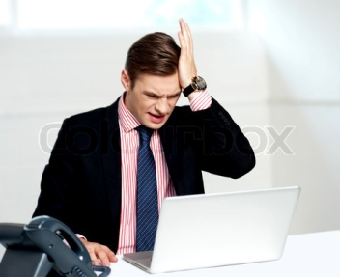
minimizing lose

Slide 32
7

Slide 33
Identification with the good (Role model)
Assimilates an aspect, property, or attribute of the other and is transformed, wholly or partially, after the model the other provides.
subject seek to negate a personal weakness by associating with and /or emulating a perceiving power figure.

Slide 34
8

Slide 35
Generalization
Find similarities, majority, or common factors, and being with all ,,,,,,,,make it applicable to entire world.

Slide 36
9

Slide 37
Verbalization to repel projective attacks
When someone ego hurts due to some reason
He/she discusses that thing with people again and again and tries to get sympathy in his/her favor. its increase the control over ego functioning.

Slide 38
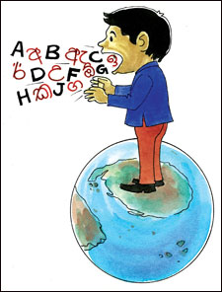
Verbalization to repel projective attacks

Slide 39
10

Slide 40
Avoidance
mentally or physically refusing to deal with of or encounter unpleasant object or situation that causes distress. Sham, and guilt.
ignore is unconscious and avoidance is conscious choice .

Slide 41
11

Slide 42
Displacement into social and political issues
Displace consciously towards political and social issues just to cope with guilt, or unplecent feeling.
compensate for another weakness, or platform of expressing or converting feeling in acceptable manners.

Slide 43
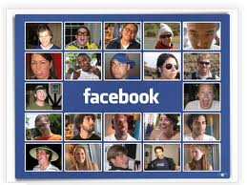
Displacement into social and political issues

Slide 44
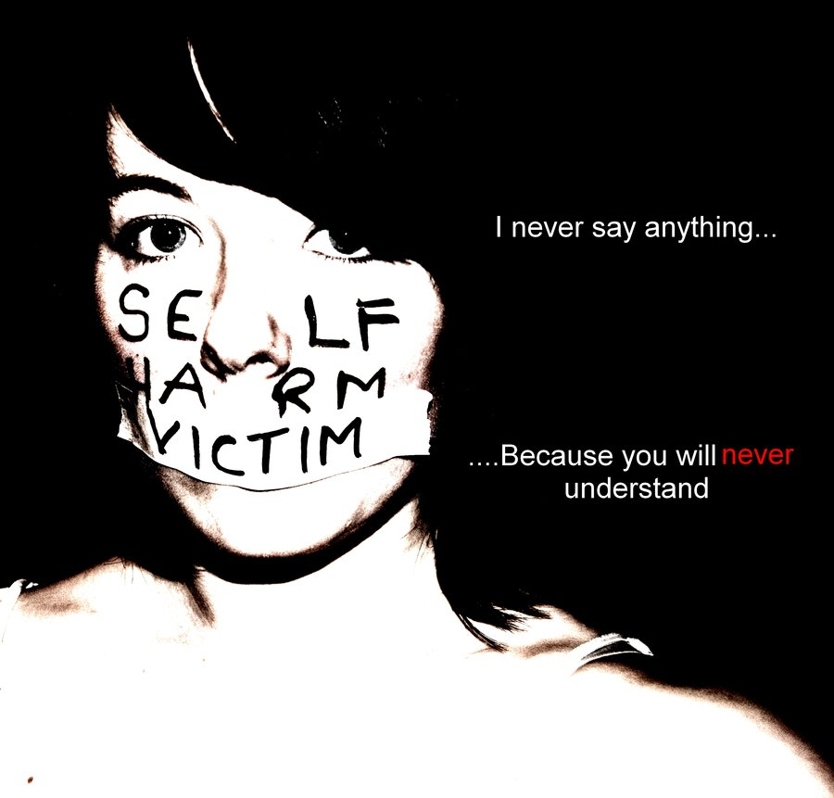
Unhealthy, poor, weak Ego defense

Slide 45
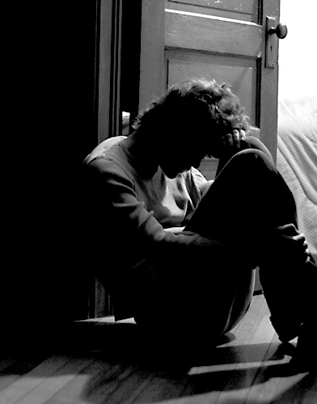
Lead to depression

Slide 46
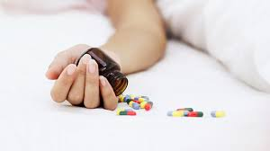
suicide

Slide 47
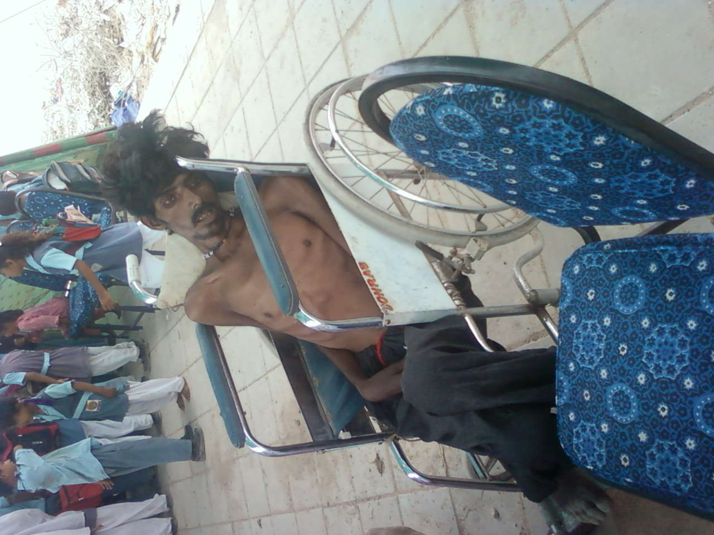
Drug addiction

Slide 48
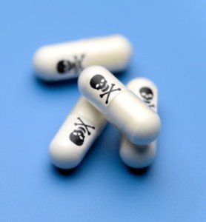
1

Slide 49
Turning to the self Anger
converted into self-hatred
Result = suicide
Help = support, family oriented psych-
pharmacological approach.

Slide 50

self Anger

Slide 51
2

Slide 52
Self punishment
Self injuring behavior
Result = suicide, addiction ,
Help = supportive therapy, reintroduce and
Reestablishment of importance of
Object- Relassion .

Slide 53
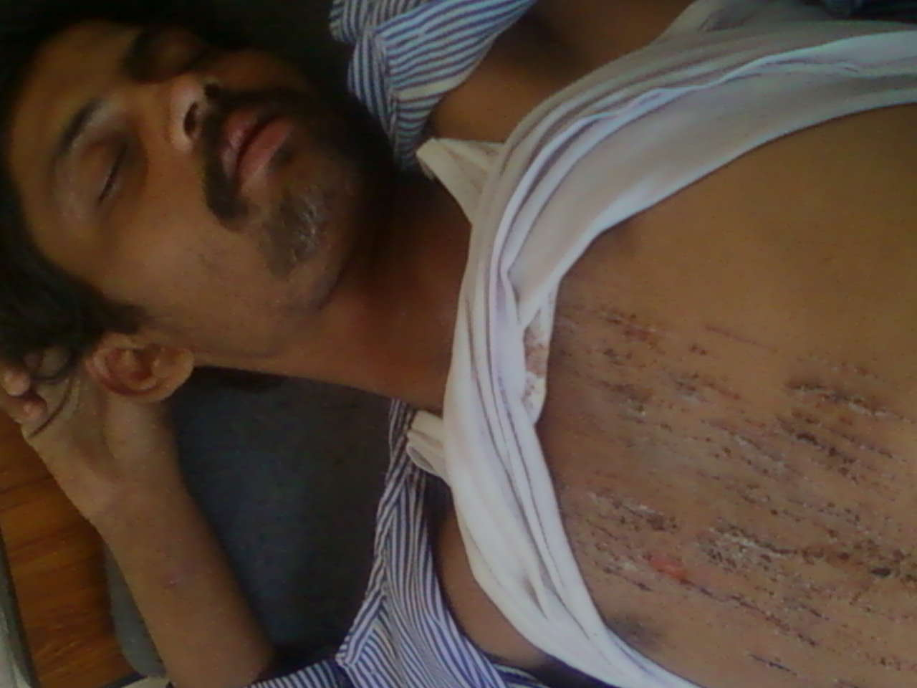

Slide 54
3

Slide 55
Minimization of grief over losses
No grief over someone they love or some ability
Or some senselessness .
Result = ego melt down, lose strength of affect
tolerance .(P,D)
Help = pharmacological treatment

Slide 56
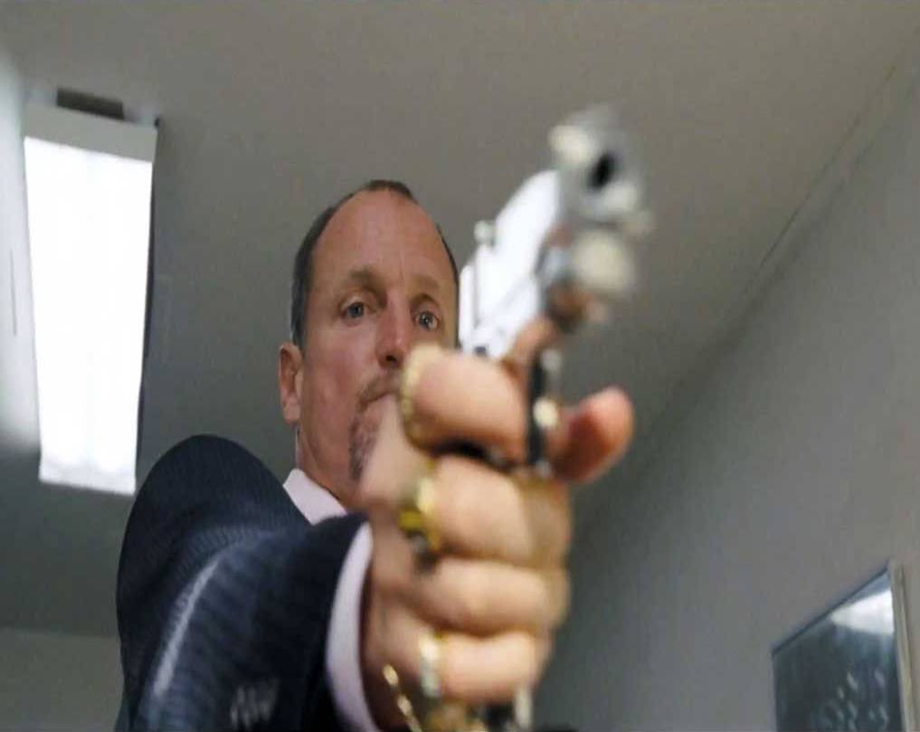
No grief

Slide 57
4

Slide 58
Reaction Formation
Being to nice, formulate reaction against guilt
behaving in the exact opposite manner, hide your true feelings
Result = drug addiction
Help = supportive therapy

Slide 59

Reaction Formation Being to nice

Slide 60
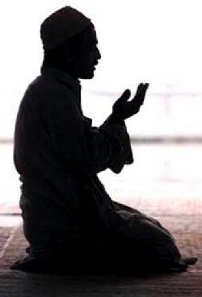
Reaction Formation(Being to nice)

Slide 61
5

Slide 62
Socialization verses shame
Hide shame or guilt (not resolve) could be unconscious or maybe denial .artificial appreciation.
Result = drug addiction
Help = Hospitalization

Slide 63
6

Slide 64
Masochistic provoking
Provoking someone to heart him to relive his guilt
Result = suicidal fantasy
Help = Intensive psychotherapy or
hospitalization .

Slide 65
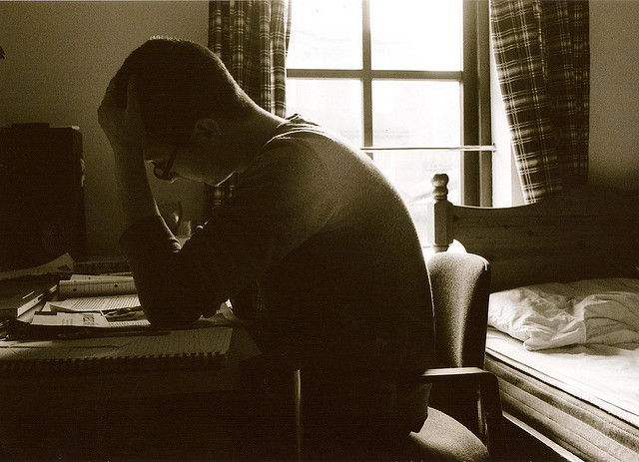
failure

Slide 66
7

Slide 67
Withdrawal from Objects
Lose all interest in their ties to others(allay some pain)
Result = sever depression ,suicidal impulses
Help = Hospitalization

Slide 68
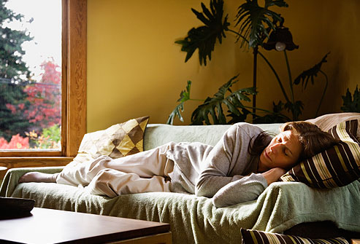
Lose all interest

Slide 69
8

Slide 70
Splitting
Contradiction in statement and behavior or splitting differently in other activates
Result = Addiction, suicidal risk.
Help = Hospitalization

Slide 71
9

Slide 72
Vagueness
Frustrated and feeling pleasure too,
intra-psychic conflict. Nighters accept nor reject.
Result = drug Addiction
Help = Psychotherapy

Slide 73
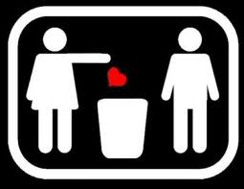
Nighters accept nor reject

Slide 74
10

Slide 75
Identification with Aggressor
Just to response that how much he consult with someone ,,,, to escape guilt
Result = Serious suicide
Help = Hospitalization

Slide 76
11

Slide 77
Denial of painful reality
Clam that having no problem, victims of traumatic events may deny that the event ever occurred.
Result = active suicide threats, drug addiction.
Help = confrontation, make him able to
accept reality .

Slide 78
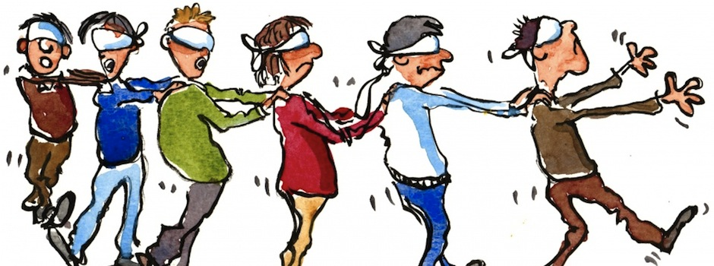
Clam that having no problem

